Slide 1
Churn Prediction
OST/Streamining
Ayshan Yariyeva
Faizan Shakeel
Shyam Vandan Mishra

Slide 2
Introduction
Churn prediction is one of the most popular Big Data use cases in business. It consists of detecting customers who are likely to cancel a subscription to a service and who will continue.

Slide 3
DataSets
Login_History
Transfer_History
Invoice_History
Party_id
Last_Login
Transaction_id
Party_id
Currency
Amount
Value_Date
Invoice_id
Party_id
Currency
TAXEXCLUSIVEAMOUNT
TAXINCLUSIVEAMOUNT
PAYABLEAMOUNT
ISSUEDATE
TAXPOINTDATE
DUEDATE

Slide 4




Technologies
Jupyter Notebook
Kafka Streams
Cassandra
Tableau

Slide 5
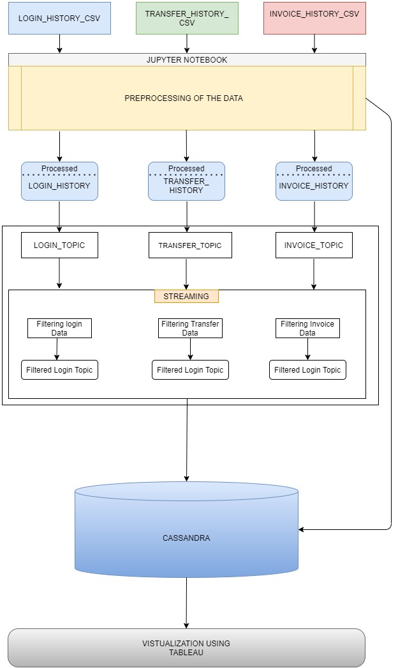
Overall System Architecture
Jupyter Notebook
Kafka Streams
Cassandra
Tableau

Slide 6
Jupyter Notebook
Processing of the data .
Checking for Missing Values.
Shirking the data
Removing Unwanted data to make it light.
Adding some useful information to the data.

Slide 7
Kafka & KStreams
Loading CSV data to Kafka producer.
Send data to KStream for data transformation.

Slide 8
Kafka Streams
Data Transformation
Based on the login counts
Based on the transaction frequency
Based on the total invoices generated

Slide 9
Data Store - Cassandra
Creating Keyspace
Table Creation
Copying data to the tables

Slide 10
Visualization
Connecting tableau with Cassandra using the Simba ODBC Connector.
Configuring it with the local server.

Slide 11
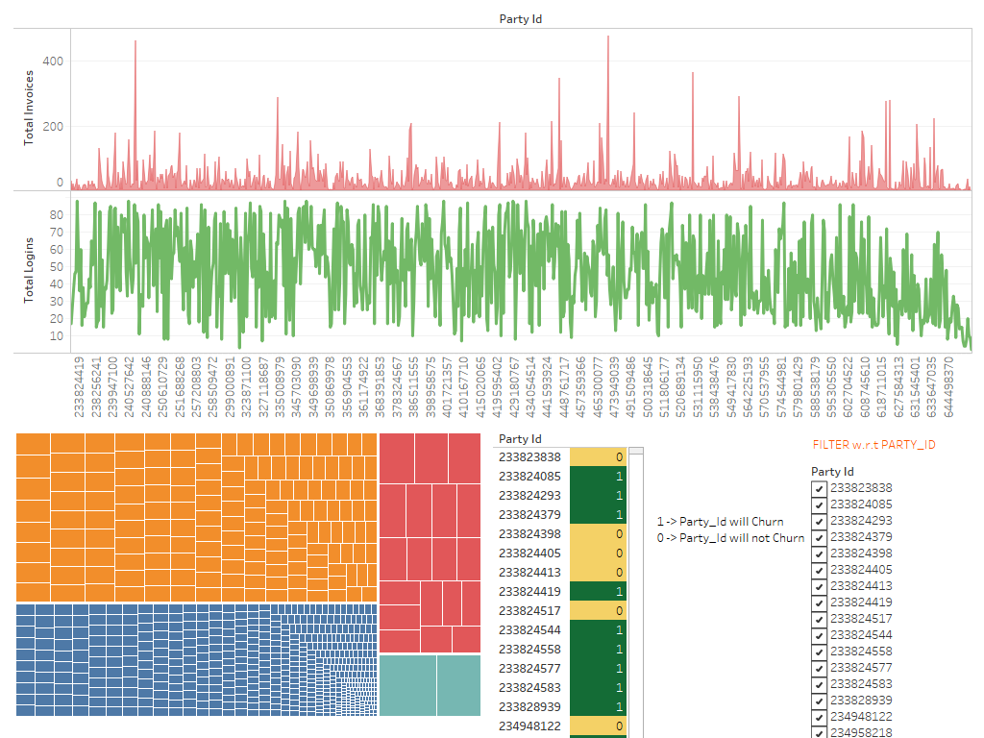
Tableau Dashboard

Slide 12
Thank You

